Slide 1
Module: Sandboxing
Into the Jail
Yan Shoshitaishvili
Arizona State University

Slide 2
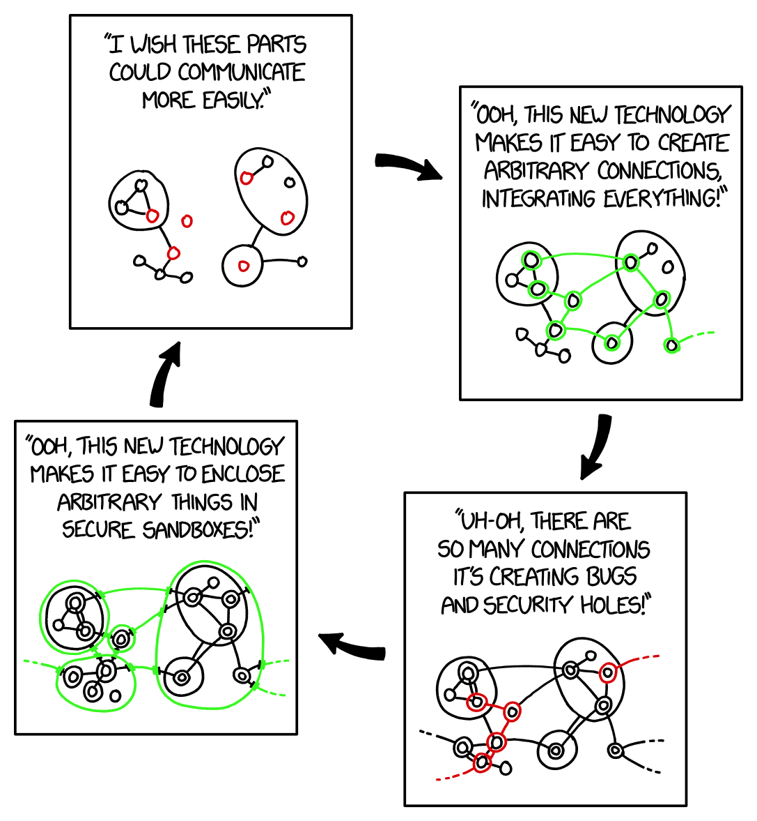
Sandboxing Cycle
https://xkcd.com/2044/

Slide 3
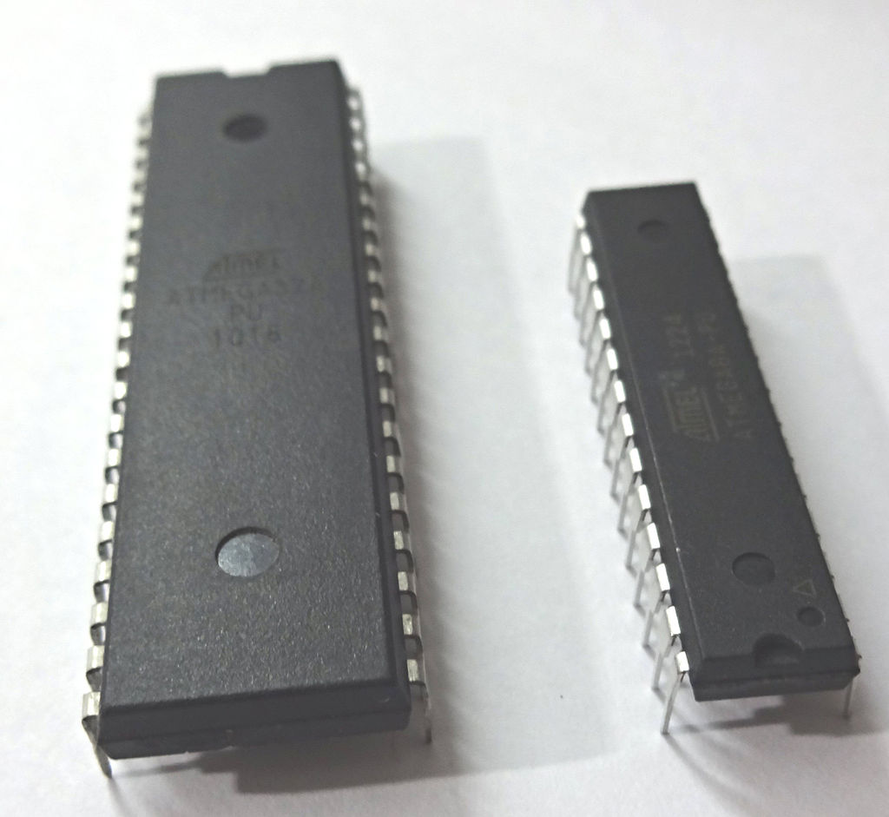
In the beginning (computing, circa 1950)...
First, everything ran on bare metal.
Problem: every process was omnipotent.
Notes:
Microcontrollers
- Code reuse (I/O, task management, for example)
- Bugs in one piece of code impacts everything
- Zero security

Slide 4
The split of OS and userspace (circa 1960)...
Hardware measures were developed to separate "system" and "process" code (1960s).
Problem: processes could still clobber each other.
Notes:
Limited address range.
Memory space (addresses) are shared between processes. One can easily modify code/data of others.

Slide 5
The rise of virtual memory (circa 1980)...
Hardware measures were developed to separate the memory space of different processes.
Notes:
Malicious code inside a process can impact other pieces of the same process. Not everything within a process is trustworthy. E.g., JavaScript

Slide 6
The rise of in-process separation (circa 1990)...
Separation between the interpreter and the interpreted code.
Notes:
Bugs can be triggered and exploited anywhere by untrusted user (attacker) input, which will lead to compromising the host system.
Or you may have users that are stupid enough to download and execute malicious programs...

Slide 7
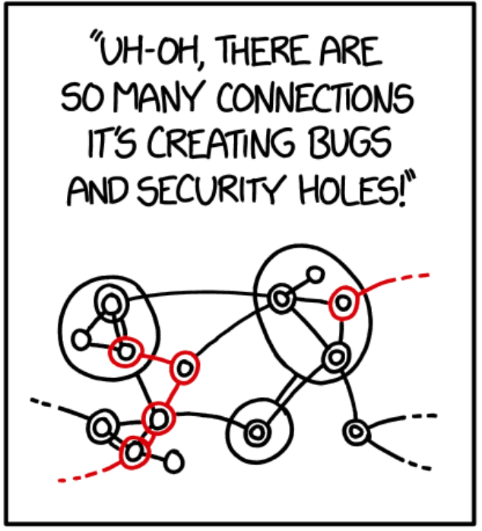
Browser hacking (circa 2000).
Link victim to malicious web page.
Trigger vulnerability.
Wreak havoc all over the victim machine.
Known as a "Drive By Download". Popular "traditional" targets:
Adobe Flash
ActiveX
Java Applets

Slide 8
Browser hacking mitigations (circa 2010).
Original solution: eliminate traditional targets.
Let's kill Adobe Flash!
Why do we even need ActiveX?
Java Applets are lame!
Turns out that this does not solve the problem. Hackers moved on to:
JavaScript engine vulnerabilities.
Media codec vulnerabilities.
Imaging library vulnerabilities.

Slide 9
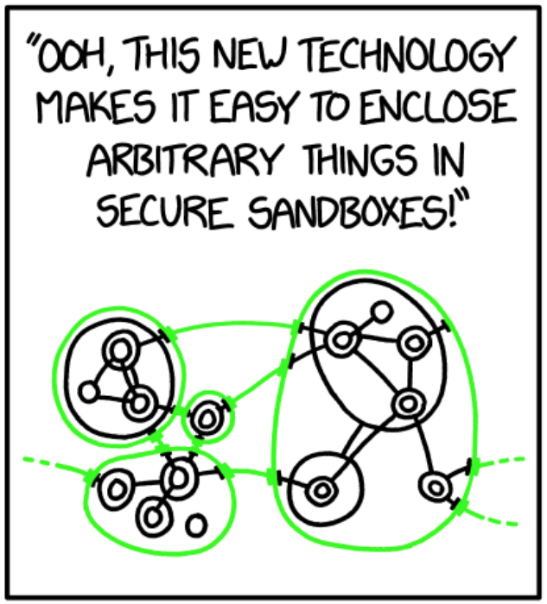
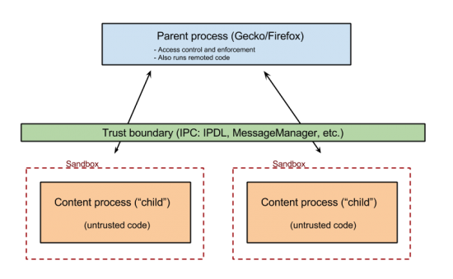
The rise of sandboxing (circa 2010)...
Untrusted code/data (i.e., downloaded JavaScript, PNGs, PDFs, etc) should live in a process with almost zero permissions.
Spawn "privileged" parent process.
Spawn "sandboxed" child processes.
When a child needs to perform a privileged action, it asks the parent.
In this module, we will learn about different sandboxing technologies and their weaknesses!

Slide 10
How well does this work?
Sandboxing is extremely effective.
In this class, we'll see several strong mitigations that are so effective that a second vulnerability is needed to bypass the mitigation and make the first vulnerability useful.
Sandboxes are a strong mitigation:
need one set of vulnerabilities to exploit sandboxed process
need another set of vulnerabilities to "break out" of the sandbox.

